Slide 1
Federal Health Information Model
Terminology Overview for LOINC
February 13, 2015

Slide 2
Federal Health Information Model
An ONC Federal Health Architecture project
Goal
Provide a framework to harmonize health data exchange among federal agencies and their partners
Biweekly meetings (1 information, 1 terminology)
~50% complete
17 of 37 domains complete, 3 in progress

Slide 3
FHIM Concept
One global model
FHIM Requirements
Model (UML)
Use
Case
Implementable
Artifacts
Logical Implementation Model (UML Profile)
MDHT generates
implementation
guide, Java classes
for selected paradigm
One for CDA, one for NIEM, etc.

Slide 4
FHIM Process
Identify interoperability requirements for domain (VA VHIM; HL7 V3, V3, FHIR; FDA; NCPDP, etc.)
Draft model
Review & revise with agency stakeholders
Stagger Terminology modeling
Publish draft to agency stakeh0lders in order to solicit feedback from those unable to attend the meetings
Revise & publish

Slide 5
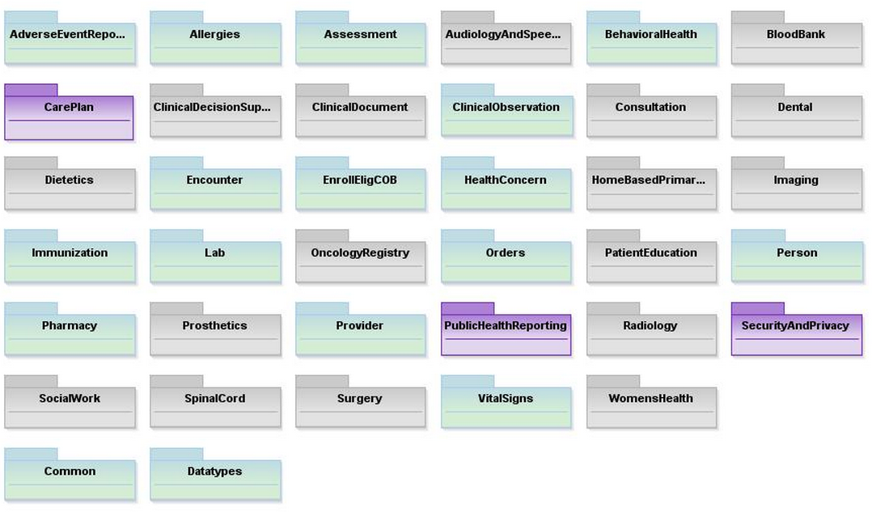
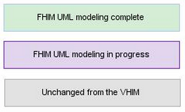
FHIM Overview

Slide 6
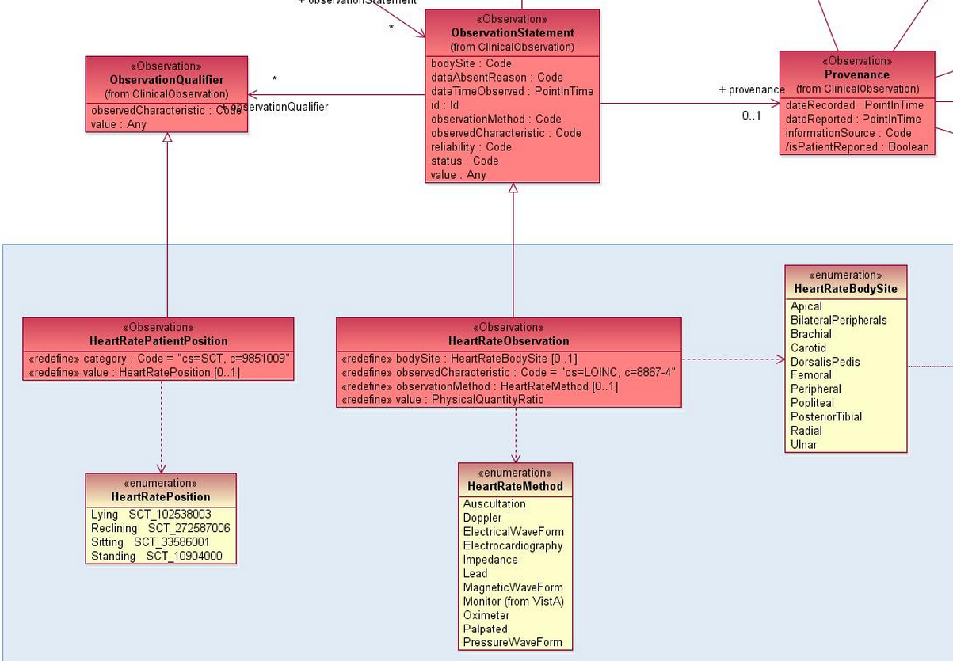
Example Clinical Model
Note: incorrect example
There is no HR position qualifier, and if
there were, it wouldn’t be named in SCT.

Slide 7
FHIM Terminology Process
Not Started
Ready for
Concept Code Creation
In Process
Ready for
FHIM review
Ready for
Publication
Ready for
Partner review
Published

Slide 8
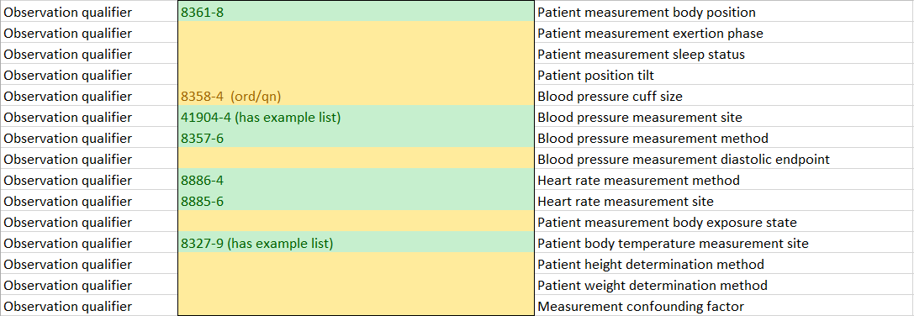
Likely Request

